Slide 1
Intermediate Machine Learning and Deep Learning Class
Elena Zennaro, Wolfgang Ecker and Lorenzo Servadei

Slide 2
Convolutional Neural Networks
Elena Zennaro, Wolfgang Ecker and Lorenzo Servadei

Slide 3
Agenda
Intro to Convolutional Neural Networks
Convolutional Neural Networks – Layers and Structures
Advancements in Convolutional Neural Networks

Slide 4
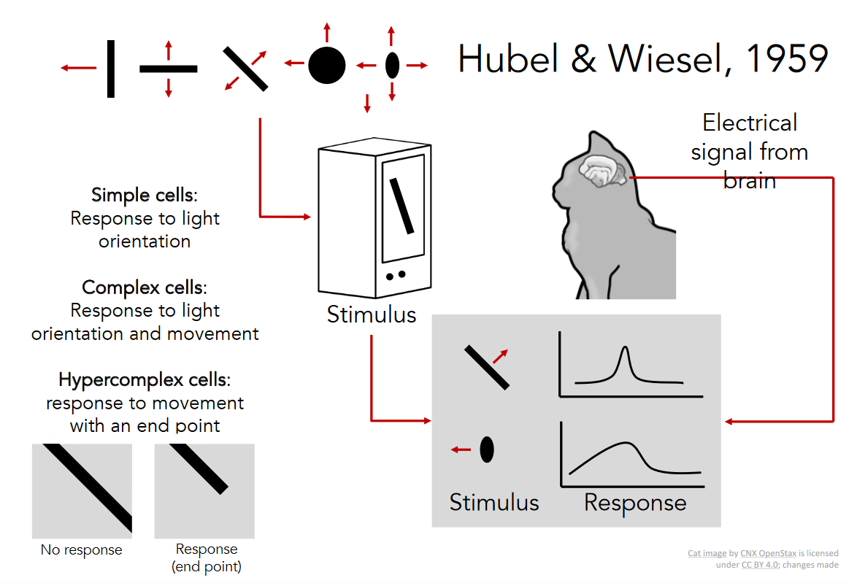
Intro to Convolutional Neural Networks

Slide 5
Agenda
Intro to Convolutional Neural Networks
Convolutional Neural Networks – Layers and Structures
Advancements in Convolutional Neural Networks

Slide 6

Fully Connected Layer
Convolutional Neural Networks – Layers and Structures
32x32x3 image -> stretch to 3072 x 1
input
activation
1
1
3072
10 x 3072
weights
10

Slide 7
Fully Connected Layer
32x32x3 image -> stretch to 3072 x 1
input
activation
1
1
10 x 3072
weighs
10
3072
1 number:
the result of taking a dot product between a row of W and the input (a 3072-dimensional dot product)
Fei-Fei Li & Justin Johnson & Serena Yeung Lecture 5 - April 18, 2017

Slide 8
Convolution Layer
32x32x3 image -> preserve spatial structure
32
height
32
depth
width
3
Fei-Fei Li & Justin Johnson & Serena Yeung Lecture 5 - April 18, 2017

Slide 9
Convolution Layer
32x32x3 image
5x5x3 filter
32
Convolve the filter with the image
i.e. “slide over the image spatially, computing dot products”
32
3

Slide 10
Convolution Layer
Filters always extend the full depth of the input volume
32x32x3 image
5x5x3 filter
32
Convolve the filter with the image
i.e. “slide over the image spatially, computing dot products”
32
3
http://www.songho.ca/dsp/convolution/convolution.html#convolution_2d April 18, 2017

Slide 11
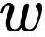
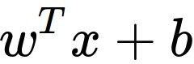
Convolution Layer
32x32x3 image 5x5x3 filter
32
1 number:
the result of taking a dot product between the filter and a small 5x5x3 chunk of the image
(i.e. 5*5*3 = 75-dimensional dot product + bias)
32
3

Slide 12
Convolution Layer
activation map
32x32x3 image 5x5x3 filter
32
28
convolve (slide) over all spatial locations
32
28
3
1
Fei-Fei Li & Justin Johnson & Serena Yeung Lecture 5 - April 18, 2017

Slide 13
Consider a second green filter
Convolution Layer
activation maps
32x32x3 image 5x5x3 filter
32
28
convolve (slide) over all spatial locations
32
28
3
1
Lecture 5 - 33
Fei-Fei Li & Justin Johnson & Serena Yeung Lecture 5 - April 18, 2017

Slide 14
For example, if we had 6 5x5 filters, we’ll get 6 separate activation maps:
activation maps
32
28
Convolution Layer
32
28
3
6
We stack these up to get a “new image” of size 28x28x6!

Slide 15
Preview: ConvNet is a sequence of Convolution Layers, interspersed with activation functions
32
28
CONV, ReLU
e.g. 6 5x5x3 filters
32
28
3
6

Slide 16
Preview: ConvNet is a sequence of Convolutional Layers, interspersed with activation functions
32
28
24
….
CONV, ReLU
e.g. 6 5x5x3 filters
CONV, ReLU
e.g. 10 5x5x6 filters
CONV, ReLU
32
28
24
3
6
10

Slide 17
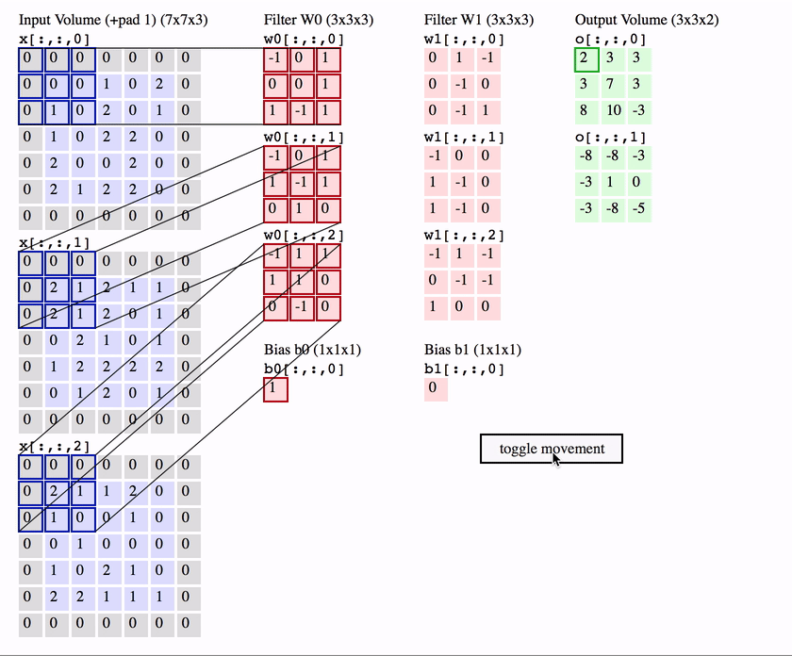

Slide 18
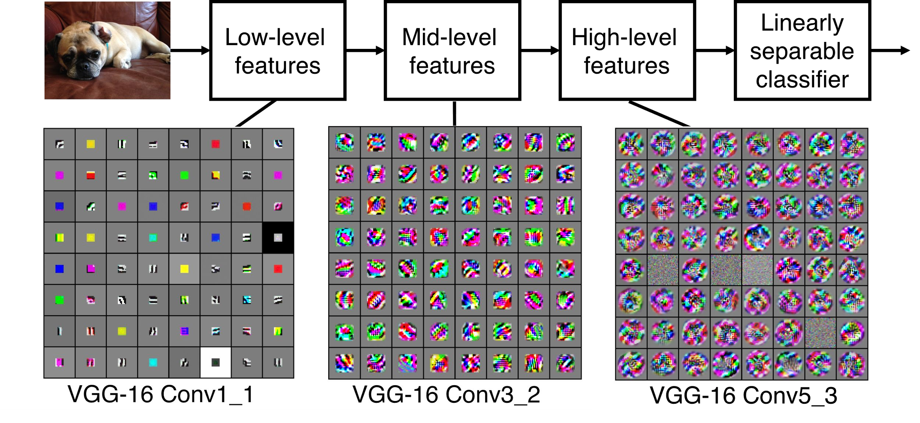
Preview
[Zeiler and Fergus 2013]
Visualization of VGG-16 by Lane McIntosh. VGG-16 architecture from [Simonyan and Zisserman 2014].

Slide 19
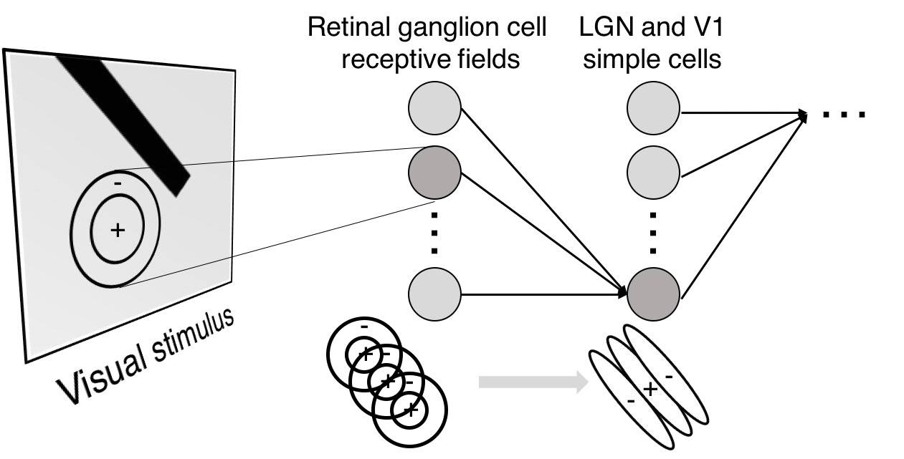
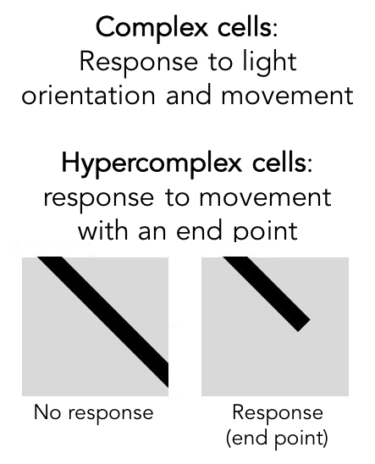
Preview

Slide 20
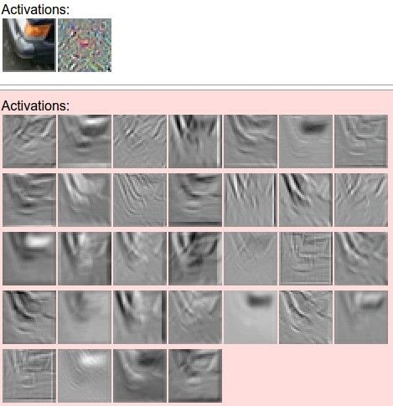
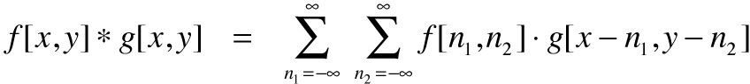
one filter =>
one activation map
example 5x5 filters
(32 total)
We call the layer convolutional because it is related to convolution of two signals:
elementwise multiplication and sum of a filter and the signal (image)
Figure copyright Andrej Karpathy.

Slide 21

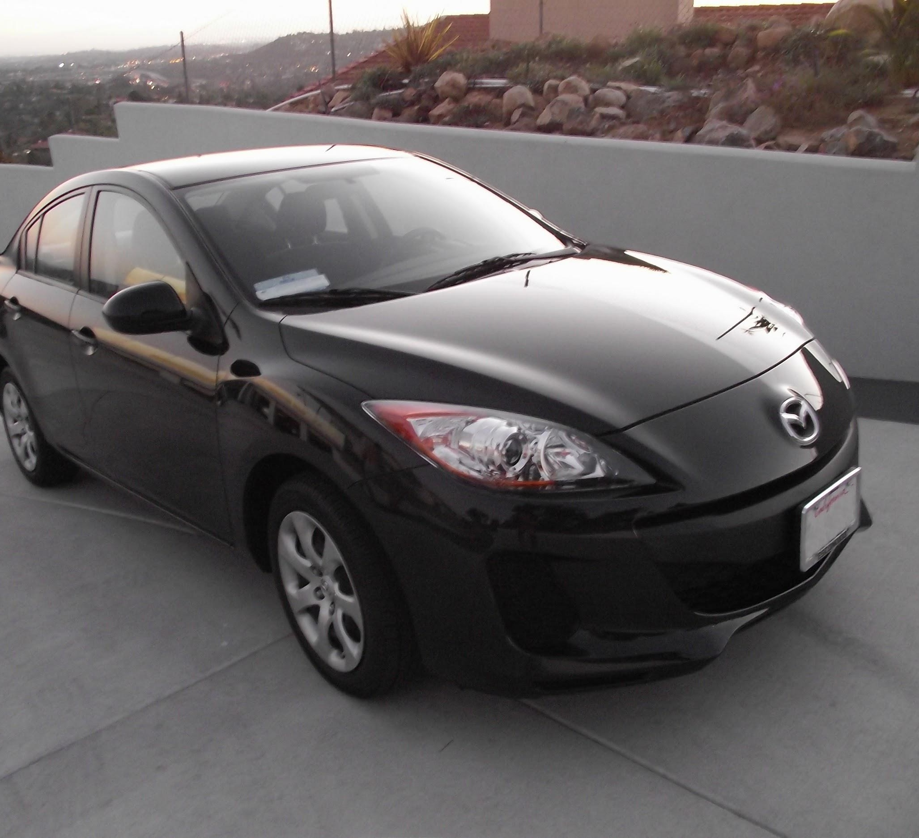
Preview

Slide 22
A closer look at spatial dimensions:
activation map
32x32x3 image 5x5x3 filter
32
28
convolve (slide) over all spatial locations
32
28
3
1

Slide 23
A closer look at spatial dimensions:
7
7x7 input (spatially) assume 3x3 filter
7

Slide 24
A closer look at spatial dimensions:
7
7x7 input (spatially) assume 3x3 filter
7

Slide 25
A closer look at spatial dimensions:
7
7x7 input (spatially) assume 3x3 filter
7

Slide 26
A closer look at spatial dimensions:
7
7x7 input (spatially) assume 3x3 filter
7

Slide 27
A closer look at spatial dimensions:
7
7x7 input (spatially) assume 3x3 filter
=> 5x5 output
7

Slide 28
A closer look at spatial dimensions:
7
7x7 input (spatially) assume 3x3 filter applied with stride 2
7

Slide 29
A closer look at spatial dimensions:
7
7x7 input (spatially) assume 3x3 filter applied with stride 2
7

Slide 30
A closer look at spatial dimensions:
7
7x7 input (spatially) assume 3x3 filter applied with stride 2
=> 3x3 output!
7

Slide 31
A closer look at spatial dimensions:
7
7x7 input (spatially) assume 3x3 filter applied with stride 3?
7

Slide 32
A closer look at spatial dimensions:
7
7x7 input (spatially) assume 3x3 filter applied with stride 3?
7
doesn’t fit!
cannot apply 3x3 filter on 7x7 input with stride 3.
Fei-Fei Li & Justin Johnson & Serena Yeung Lecture 5 - April 18, 2017

Slide 33
N
Output size:
(N - F) / stride + 1
 |  |  | F
 | F
e.g. N = 7, F = 3:
stride 1 => (7 - 3)/1 + 1 = 5
stride 2 => (7 - 3)/2 + 1 = 3
stride 3 => (7 - 3)/3 + 1 = 2.33 :\
N

Slide 34
In practice: Common to zero pad the border
0 | 0 | 0 | 0 | 0 | 0
0
0
0
0
e.g. input 7x7
3x3 filter, applied with stride 1
pad with 1 pixel border => what is the output?

Slide 35
In practice: Common to zero pad the border
0 | 0 | 0 | 0 | 0 | 0
0
0
0
0
e.g. input 7x7
3x3 filter, applied with stride 1
pad with 1 pixel border => what is the output?
(recall:)
(N - F) / stride + 1

Slide 36
In practice: Common to zero pad the border
0 | 0 | 0 | 0 | 0 | 0
0
0
0
0
e.g. input 7x7
3x3 filter, applied with stride 1
pad with 1 pixel border => what is the output?
7x7 output!

Slide 37
In practice: Common to zero pad the border
0 | 0 | 0 | 0 | 0 | 0
0
0
0
0
e.g. input 7x7
3x3 filter, applied with stride 1
pad with 1 pixel border => what is the output?
7x7 output!
in general, common to see CONV layers with stride 1, filters of size FxF, and zero-padding with (F-1)/2. (will preserve size spatially)
e.g. F = 3 => zero pad with 1 F = 5 => zero pad with 2 F = 7 => zero pad with 3

Slide 38
Remember back to…
E.g. 32x32 input convolved repeatedly with 5x5 filters shrinks volumes spatially! (32 -> 28 -> 24 ...). Shrinking too fast is not good, doesn’t work well.
32
28
24
….
CONV, ReLU
e.g. 6 5x5x3 filters
CONV, ReLU
e.g. 10 5x5x6 filters
CONV, ReLU
32
28
24
3
6
10

Slide 39
Examples time:
Input volume: 32x32x3
10 5x5 filters with stride 1, pad 2
Output volume size: ?
Notes:
32X32X´10

Slide 40
Examples time:
Input volume: 32x32x3
10 5x5 filters with stride 1, pad 2
Output volume size:
(32+2*2-5)/1+1 = 32 spatially, so
32x32x10

Slide 41
Examples time:
Input volume: 32x32x3
10 5x5 filters with stride 1, pad 2
Number of parameters in this layer?

Slide 42
Examples time:
Input volume: 32x32x3
10 5x5 filters with stride 1, pad 2
Number of parameters in this layer? each filter has 5*5*3 + 1 = 76 params
=> 76*10 = 760
(+1 for bias)

Slide 43
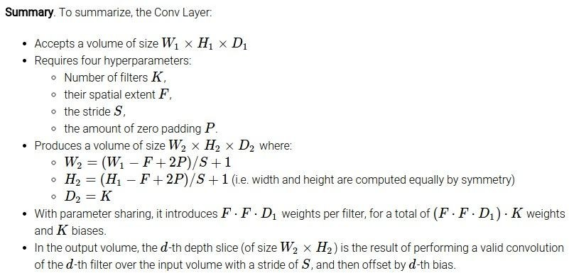

Slide 44
Common settings:
K = (powers of 2, e.g. 32, 64, 128, 512)
- F = 3, S = 1, P = 1
- F = 5, S = 1, P = 2
- F = 5, S = 2, P = ? (whatever fits)
- F = 1, S = 1, P = 0

Slide 45
(btw, 1x1 convolution layers make perfect sense)
1x1 CONV
with 32 filters
56
56
(each filter has size 1x1x64, and performs a 64-dimensional dot product)
56
56
64
32

Slide 46
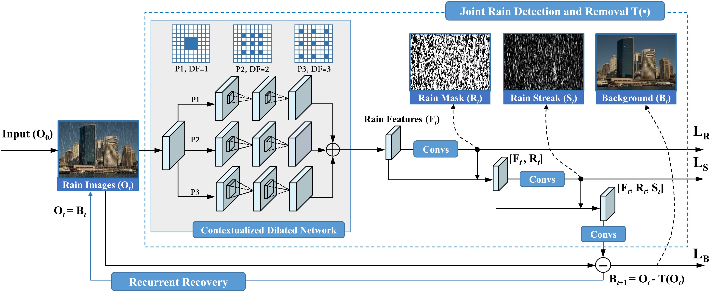
Dilated Convolution
http://www.icst.pku.edu.cn/struct/Projects/joint_rain_removal.html

Slide 47
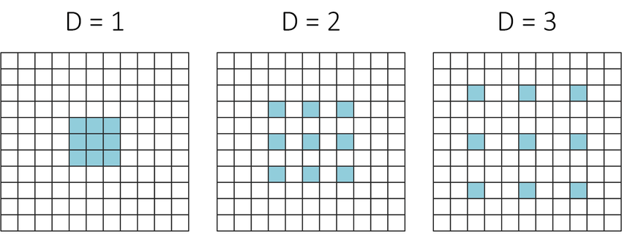
Dilated Convolution

Slide 48
The brain/neuron view of CONV Layer
32x32x3 image 5x5x3 filter
32
1 number:
the result of taking a dot product between the filter and this part of the image
(i.e. 5*5*3 = 75-dimensional dot product)
32
3

Slide 49
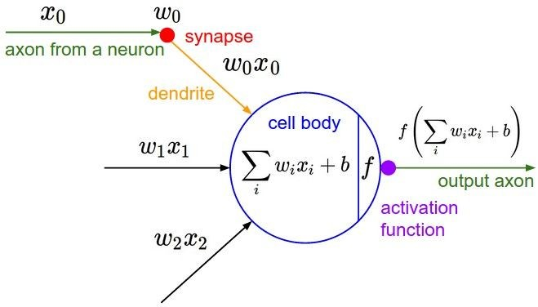
The brain/neuron view of CONV Layer
32x32x3 image 5x5x3 filter
32
It’s just a neuron with local connectivity...
1 number:
the result of taking a dot product between the filter and this part of the image
(i.e. 5*5*3 = 75-dimensional dot product)
32
3

Slide 50
The brain/neuron view of CONV Layer
32
28
An activation map is a 28x28 sheet of neuron outputs:
Each is connected to a small region in the input
All of them share parameters
32
28
3
“5x5 filter” -> “5x5 receptive field for each neuron”

Slide 51
The brain/neuron view of CONV Layer
32
28
E.g. with 5 filters,
CONV layer consists of neurons arranged in a 3D grid (28x28x5)
There will be 5 different neurons all looking at the same region in the input volume
32
28
3
5

Slide 52
Two more layers to go: POOL/FC

Slide 53
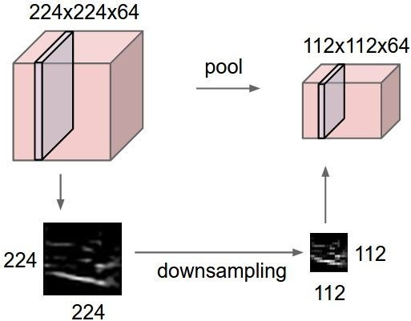
Pooling layer
makes the representations smaller and more manageable
operates over each activation map independently:

Slide 54
Max Pooling
Single depth slice
1 | 1 | 2 | 4
5 | 6 | 7 | 8
3 | 2 | 1 | 0
1 | 2 | 3 | 4
x
max pool with 2x2 filters and stride 2
6 | 8
3 | 4
y

Slide 55
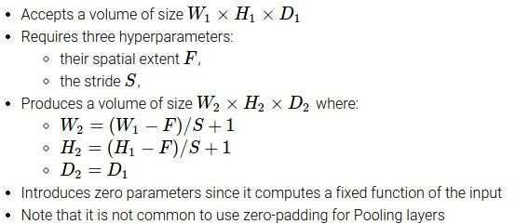

Slide 56
Common settings:
F = 2, S = 2
F = 3, S = 2

Slide 57
Fully Connected Layer (FC layer)
- Contains neurons that connect to the entire input volume, as in ordinary Neural Networks

Slide 58
Reminder: Fully Connected Layer
Each neuron looks at the full input volume
32x32x3 image -> stretch to 3072 x 1
input
activation
1
1
3072
10 x 3072
weights
10
1 number:
the result of taking a dot product between a row of W and the input (a 3072-dimensional dot product)

Slide 59
Summary
ConvNets stack CONV,POOL,FC layers
Trend towards smaller filters and deeper architectures
Trend towards getting rid of POOL/FC layers (just CONV)
Typical architectures look like
[(CONV-RELU)*N-POOL?]*M-(FC-RELU)*K,SOFTMAX
where N is usually up to ~5, M is large, 0 <= K <= 2.
- but recent advances such as ResNet/GoogLeNet challenge this paradigm
Fei-Fei Li & Justin Johnson & Serena Yeung Lecture 5 - April 18, 2017

Slide 60
Today: CNN Architectures
Case Studies
AlexNet
VGG
GoogLeNet
ResNet
Also....
NiN (Network in Network)
Wide ResNet
ResNeXT
Stochastic Depth
DenseNet
FractalNet
SqueezeNet
Xception Module
Lecture 9 -
60

Slide 61
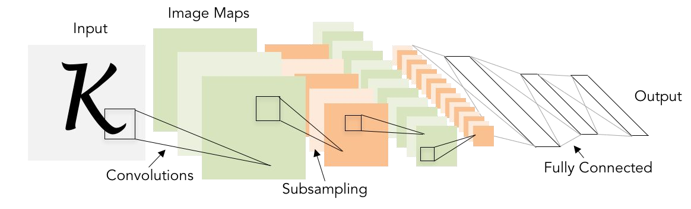
Review: LeNet-5
[LeCun et al., 1998]
Conv filters were 5x5, applied at stride 1
Subsampling (Pooling) layers were 2x2 applied at stride 2
i.e. architecture is [CONV-POOL-CONV-POOL-FC-FC]
Lecture 9 -
61

Slide 62
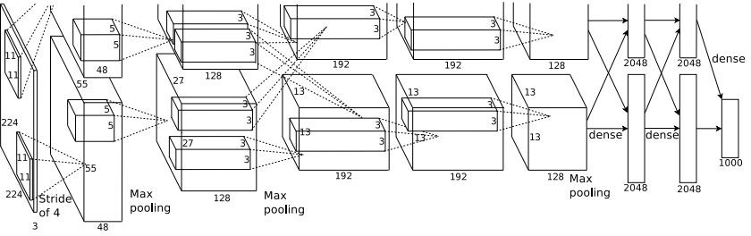
Case Study: AlexNet
[Krizhevsky et al. 2012]
Architecture:
CONV1 MAX POOL1 NORM1 CONV2 MAX POOL2 NORM2 CONV3 CONV4 CONV5
Max POOL3 FC6
FC7 FC8
Lecture 9 - 62
Fei-Fei Li & Justin Johnson & Serena Yeung Lecture 9 - May 2, 2017

Slide 63
Case Study: AlexNet
[Krizhevsky et al. 2012]
Input: 227x227x3 images
First layer (CONV1): 96 11x11 filters applied at stride 4
=>
Q: what is the output volume size? Hint: (227-11)/4+1 = 55
Lecture 9 - 63
Fei-Fei Li & Justin Johnson & Serena Yeung Lecture 9 - May 2, 2017

Slide 64
Case Study: AlexNet
[Krizhevsky et al. 2012]
Input: 227x227x3 images
First layer (CONV1): 96 11x11 filters applied at stride 4
=>
Output volume [55x55x96]
Q: What is the total number of parameters in this layer?
Lecture 9 - 64
Fei-Fei Li & Justin Johnson & Serena Yeung Lecture 9 - May 2, 2017

Slide 65
Case Study: AlexNet
[Krizhevsky et al. 2012]
Input: 227x227x3 images
First layer (CONV1): 96 11x11 filters applied at stride 4
=>
Output volume [55x55x96]
Parameters: (11*11*3)*96 = 35K
Lecture 9 - 65
Fei-Fei Li & Justin Johnson & Serena Yeung Lecture 9 - May 2, 2017

Slide 66
Case Study: AlexNet
[Krizhevsky et al. 2012]
Input: 227x227x3 images After CONV1: 55x55x96
Second layer (POOL1): 3x3 filters applied at stride 2 Q: what is the output volume size? Hint: (55-3)/2+1 = 27
Lecture 9 - 66
Fei-Fei Li & Justin Johnson & Serena Yeung Lecture 9 - May 2, 2017

Slide 67
Case Study: AlexNet
[Krizhevsky et al. 2012]
Input: 227x227x3 images After CONV1: 55x55x96
Second layer (POOL1): 3x3 filters applied at stride 2 Output volume: 27x27x96
Q: what is the number of parameters in this layer?
Lecture 9 - 67
Fei-Fei Li & Justin Johnson & Serena Yeung Lecture 9 - May 2, 2017

Slide 68
Case Study: AlexNet
[Krizhevsky et al. 2012]
Input: 227x227x3 images After CONV1: 55x55x96
Second layer (POOL1): 3x3 filters applied at stride 2 Output volume: 27x27x96
Parameters: 0!
Lecture 9 - 68
Fei-Fei Li & Justin Johnson & Serena Yeung Lecture 9 - May 2, 2017

Slide 69
Case Study: AlexNet
[Krizhevsky et al. 2012]
Input: 227x227x3 images After CONV1: 55x55x96 After POOL1: 27x27x96
...
Lecture 9 - 69
Fei-Fei Li & Justin Johnson & Serena Yeung Lecture 9 - May 2, 2017

Slide 70
Case Study: AlexNet
[Krizhevsky et al. 2012]
Full (simplified) AlexNet architecture: [227x227x3] INPUT
[55x55x96] CONV1: 96 11x11 filters at stride 4, pad 0 [27x27x96] MAX POOL1: 3x3 filters at stride 2 [27x27x96] NORM1: Normalization layer
[27x27x256] CONV2: 256 5x5 filters at stride 1, pad 2 [13x13x256] MAX POOL2: 3x3 filters at stride 2 [13x13x256] NORM2: Normalization layer [13x13x384] CONV3: 384 3x3 filters at stride 1, pad 1 [13x13x384] CONV4: 384 3x3 filters at stride 1, pad 1 [13x13x256] CONV5: 256 3x3 filters at stride 1, pad 1 [6x6x256] MAX POOL3: 3x3 filters at stride 2
[4096] FC6: 4096 neurons
[4096] FC7: 4096 neurons
[1000] FC8: 1000 neurons (class scores)
Lecture 9 - 70
Fei-Fei Li & Justin Johnson & Serena Yeung Lecture 9 - May 2, 2017

Slide 71
Case Study: AlexNet
[Krizhevsky et al. 2012]
Full (simplified) AlexNet architecture: [227x227x3] INPUT
[55x55x96] CONV1: 96 11x11 filters at stride 4, pad 0 [27x27x96] MAX POOL1: 3x3 filters at stride 2 [27x27x96] NORM1: Normalization layer
[27x27x256] CONV2: 256 5x5 filters at stride 1, pad 2 [13x13x256] MAX POOL2: 3x3 filters at stride 2 [13x13x256] NORM2: Normalization layer [13x13x384] CONV3: 384 3x3 filters at stride 1, pad 1 [13x13x384] CONV4: 384 3x3 filters at stride 1, pad 1 [13x13x256] CONV5: 256 3x3 filters at stride 1, pad 1 [6x6x256] MAX POOL3: 3x3 filters at stride 2
Details/Retrospectives:
first use of ReLU
used Norm layers (not common anymore)
heavy data augmentation
dropout 0.5
batch size 128
SGD Momentum 0.9
Learning rate 1e-2, reduced by 10 manually when val accuracy plateaus
L2 weight decay 5e-4
[4096] FC6: 4096 neurons
[4096] FC7: 4096 neurons
[1000] FC8: 1000 neurons (class scores)
- 7 CNN ensemble: 18.2% -> 15.4%
Fei-Fei Li & Justin Johnson & Serena Yeung Lecture 9 - May 2, 2017

Slide 72
Case Study: AlexNet
[Krizhevsky et al. 2012]
Full (simplified) AlexNet architecture: [227x227x3] INPUT
[55x55x96] CONV1: 96 11x11 filters at stride 4, pad 0 [27x27x96] MAX POOL1: 3x3 filters at stride 2
[55x55x48] x 2
[27x27x96] NORM1: Normalization layer
[27x27x256] CONV2: 256 5x5 filters at stride 1, pad 2 [13x13x256] MAX POOL2: 3x3 filters at stride 2 [13x13x256] NORM2: Normalization layer [13x13x384] CONV3: 384 3x3 filters at stride 1, pad 1 [13x13x384] CONV4: 384 3x3 filters at stride 1, pad 1 [13x13x256] CONV5: 256 3x3 filters at stride 1, pad 1
Historical note: Trained on GTX 580 GPU with only 3 GB of memory.
Network spread across 2 GPUs, half the neurons (feature maps) on each GPU.
[6x6x256] MAX POOL3: 3x3 filters at stride 2 [4096] FC6: 4096 neurons
[4096] FC7: 4096 neurons
[1000] FC8: 1000 neurons (class scores)
Fei-Fei Li & Justin Johnson & Serena Yeung Lecture 9 - May 2, 2017

Slide 73
Case Study: AlexNet
[Krizhevsky et al. 2012]
Full (simplified) AlexNet architecture: [227x227x3] INPUT
[55x55x96] CONV1: 96 11x11 filters at stride 4, pad 0 [27x27x96] MAX POOL1: 3x3 filters at stride 2 [27x27x96] NORM1: Normalization layer
[27x27x256] CONV2: 256 5x5 filters at stride 1, pad 2 [13x13x256] MAX POOL2: 3x3 filters at stride 2 [13x13x256] NORM2: Normalization layer [13x13x384] CONV3: 384 3x3 filters at stride 1, pad 1 [13x13x384] CONV4: 384 3x3 filters at stride 1, pad 1 [13x13x256] CONV5: 256 3x3 filters at stride 1, pad 1
CONV1, CONV2, CONV4, CONV5:
Connections only with feature maps on same GPU
[6x6x256] MAX POOL3: 3x3 filters at stride 2 [4096] FC6: 4096 neurons
[4096] FC7: 4096 neurons
[1000] FC8: 1000 neurons (class scores)
Fei-Fei Li & Justin Johnson & Serena Yeung Lecture 9 - May 2, 2017

Slide 74
Case Study: AlexNet
[Krizhevsky et al. 2012]
Full (simplified) AlexNet architecture: [227x227x3] INPUT
[55x55x96] CONV1: 96 11x11 filters at stride 4, pad 0 [27x27x96] MAX POOL1: 3x3 filters at stride 2 [27x27x96] NORM1: Normalization layer
[27x27x256] CONV2: 256 5x5 filters at stride 1, pad 2 [13x13x256] MAX POOL2: 3x3 filters at stride 2 [13x13x256] NORM2: Normalization layer [13x13x384] CONV3: 384 3x3 filters at stride 1, pad 1 [13x13x384] CONV4: 384 3x3 filters at stride 1, pad 1 [13x13x256] CONV5: 256 3x3 filters at stride 1, pad 1 [6x6x256] MAX POOL3: 3x3 filters at stride 2
[4096] FC6: 4096 neurons
[4096] FC7: 4096 neurons
[1000] FC8: 1000 neurons (class scores)
CONV3, FC6, FC7, FC8:
Connections with all feature maps in preceding layer, communication across GPUs
Fei-Fei Li & Justin Johnson & Serena Yeung Lecture 9 - May 2, 2017

Slide 75
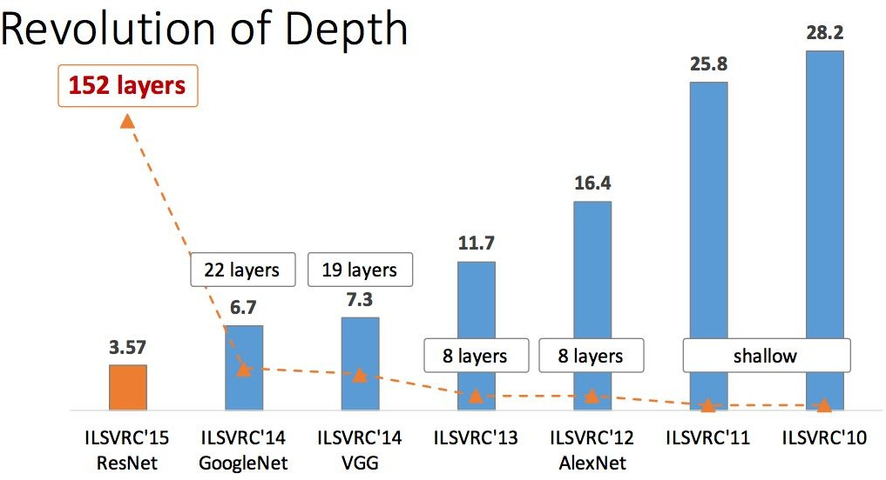
ImageNet Large Scale Visual Recognition Challenge (ILSVRC) winners
First CNN-based winner
Fei-Fei Li & Justin Johnson & Serena Yeung Lecture 9 - May 2, 2017

Slide 76
ImageNet Large Scale Visual Recognition Challenge (ILSVRC) winners
ZFNet: Improved hyperparameters over AlexNet
Fei-Fei Li & Justin Johnson & Serena Yeung Lecture 9 - May 2, 2017

Slide 77
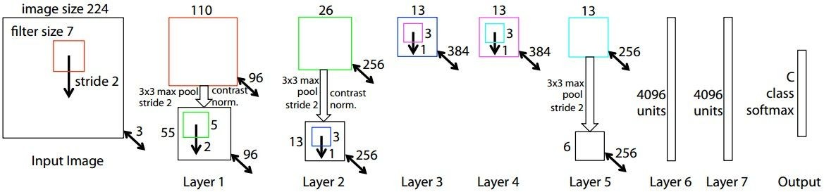
ZFNet
[Zeiler and Fergus, 2013]
TODO: remake figure
AlexNet but:
CONV1: change from (11x11 stride 4) to (7x7 stride 2) CONV3,4,5: instead of 384, 384, 256 filters use 512, 1024, 512
ImageNet top 5 error: 16.4% -> 11.7%
Fei-Fei Li & Justin Johnson & Serena Yeung Lecture 9 - May 2, 2017

Slide 78
ImageNet Large Scale Visual Recognition Challenge (ILSVRC) winners
Deeper Networks
Fei-Fei Li & Justin Johnson & Serena Yeung Lecture 9 - May 2, 2017

Slide 79
Case Study: VGGNet
[Simonyan and Zisserman, 2014]
Softmax
FC 1000
FC 4096
FC 4096
Pool
3x3 conv, 512
3x3 conv, 512
3x3 conv, 512
3x3 conv, 512
Pool
3x3 conv, 512
3x3 conv, 512
3x3 conv, 512
3x3 conv, 512
Pool
3x3 conv, 256
3x3 conv, 256
Pool
3x3 conv, 128
3x3 conv, 128
Pool
3x3 conv, 64
3x3 conv, 64
Input
Softmax
FC 1000
FC 4096
FC 4096
Pool
3x3 conv, 512
3x3 conv, 512
3x3 conv, 512
Pool
3x3 conv, 512
3x3 conv, 512
Small filters, Deeper networks
8 layers (AlexNet)
-> 16 - 19 layers (VGG16Net)
Only 3x3 CONV stride 1, pad 1 and 2x2 MAX POOL stride 2
Softmax
FC 1000
FC 4096
FC 4096
Pool
3x3 conv, 256
3x3 conv, 384
Pool
3x3 conv, 384
Pool
5x5 conv, 256
11x11 conv, 96
Input
3x3 conv, 512
Pool
3x3 conv, 256
3x3 conv, 256
Pool
3x3 conv, 128
3x3 conv, 128
Pool
3x3 conv, 64
3x3 conv, 64
Input
11.7% top 5 error in ILSVRC’13 (ZFNet)
-> 7.3% top 5 error in ILSVRC’14
AlexNet
VGG16
VGG19
Fei-Fei Li & Justin Johnson & Serena Yeung Lecture 9 - May 2, 2017

Slide 80
Case Study: VGGNet
[Simonyan and Zisserman, 2014]
Softmax
FC 1000
FC 4096
FC 4096
Pool
3x3 conv, 512
3x3 conv, 512
3x3 conv, 512
3x3 conv, 512
Pool
3x3 conv, 512
3x3 conv, 512
3x3 conv, 512
3x3 conv, 512
Pool
3x3 conv, 256
3x3 conv, 256
Pool
3x3 conv, 128
3x3 conv, 128
Pool
3x3 conv, 64
3x3 conv, 64
Input
Softmax
FC 1000
FC 4096
FC 4096
Pool
3x3 conv, 512
3x3 conv, 512
3x3 conv, 512
Pool
3x3 conv, 512
3x3 conv, 512
Q: Why use smaller filters? (3x3 conv)
Softmax
FC 1000
FC 4096
FC 4096
Pool
3x3 conv, 256
3x3 conv, 384
Pool
3x3 conv, 384
Pool
5x5 conv, 256
11x11 conv, 96
Input
3x3 conv, 512
Pool
3x3 conv, 256
3x3 conv, 256
Pool
3x3 conv, 128
3x3 conv, 128
Pool
3x3 conv, 64
3x3 conv, 64
Input
AlexNet
VGG16
VGG19
Fei-Fei Li & Justin Johnson & Serena Yeung Lecture 9 - May 2, 2017

Slide 81
Case Study: VGGNet
[Simonyan and Zisserman, 2014]
Softmax
FC 1000
FC 4096
FC 4096
Pool
3x3 conv, 512
3x3 conv, 512
3x3 conv, 512
3x3 conv, 512
Pool
3x3 conv, 512
3x3 conv, 512
3x3 conv, 512
3x3 conv, 512
Pool
3x3 conv, 256
3x3 conv, 256
Pool
3x3 conv, 128
3x3 conv, 128
Pool
3x3 conv, 64
3x3 conv, 64
Input
Softmax
FC 1000
FC 4096
FC 4096
Pool
3x3 conv, 512
3x3 conv, 512
3x3 conv, 512
Pool
3x3 conv, 512
3x3 conv, 512
Q: Why use smaller filters? (3x3 conv)
Stack of three 3x3 conv (stride 1) layers has same effective receptive field as one 7x7 conv layer
Q: What is the effective receptive field of three 3x3 conv (stride 1) layers?
Softmax
FC 1000
FC 4096
FC 4096
Pool
3x3 conv, 256
3x3 conv, 384
Pool
3x3 conv, 384
Pool
5x5 conv, 256
11x11 conv, 96
Input
3x3 conv, 512
Pool
3x3 conv, 256
3x3 conv, 256
Pool
3x3 conv, 128
3x3 conv, 128
Pool
3x3 conv, 64
3x3 conv, 64
Input
AlexNet
VGG16
VGG19
Fei-Fei Li & Justin Johnson & Serena Yeung Lecture 9 - May 2, 2017

Slide 82
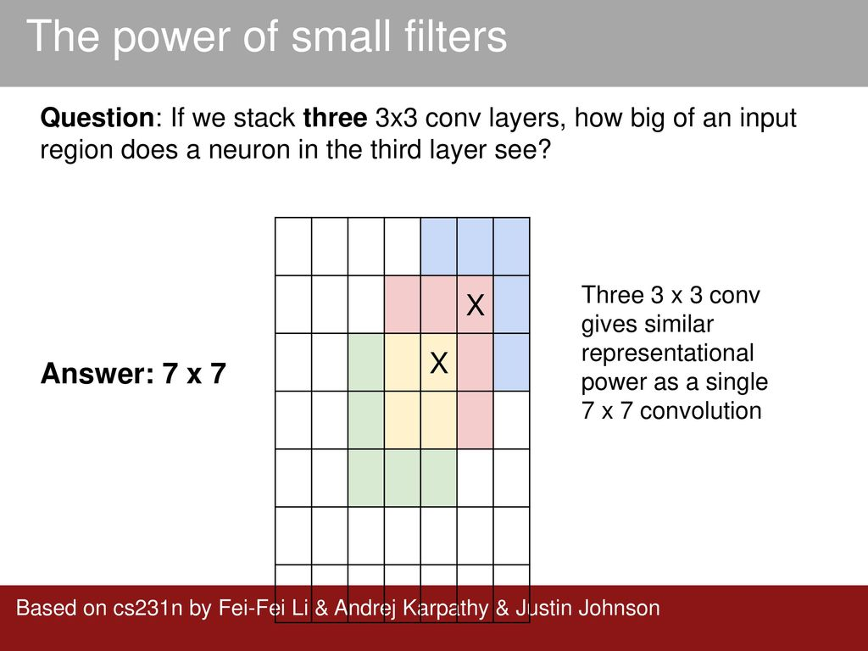

Slide 83
Case Study: VGGNet
[Simonyan and Zisserman, 2014]
Softmax
FC 1000
FC 4096
FC 4096
Pool
3x3 conv, 512
3x3 conv, 512
3x3 conv, 512
3x3 conv, 512
Pool
3x3 conv, 512
3x3 conv, 512
3x3 conv, 512
3x3 conv, 512
Pool
3x3 conv, 256
3x3 conv, 256
Pool
3x3 conv, 128
3x3 conv, 128
Pool
3x3 conv, 64
3x3 conv, 64
Input
Softmax
FC 1000
FC 4096
FC 4096
Pool
3x3 conv, 512
3x3 conv, 512
3x3 conv, 512
Pool
3x3 conv, 512
3x3 conv, 512
Q: Why use smaller filters? (3x3 conv)
Softmax
FC 1000
FC 4096
FC 4096
Pool
3x3 conv, 256
3x3 conv, 384
Pool
3x3 conv, 384
Pool
5x5 conv, 256
11x11 conv, 96
Input
Stack of three 3x3 conv (stride 1) layers has same effective receptive field as one 7x7 conv layer
[7x7]
3x3 conv, 512
Pool
3x3 conv, 256
3x3 conv, 256
Pool
3x3 conv, 128
3x3 conv, 128
Pool
3x3 conv, 64
3x3 conv, 64
Input
AlexNet
VGG16
VGG19
Fei-Fei Li & Justin Johnson & Serena Yeung Lecture 9 - May 2, 2017

Slide 84
Case Study: VGGNet
[Simonyan and Zisserman, 2014]
Softmax
FC 1000
FC 4096
FC 4096
Pool
3x3 conv, 512
3x3 conv, 512
3x3 conv, 512
3x3 conv, 512
Pool
3x3 conv, 512
3x3 conv, 512
3x3 conv, 512
3x3 conv, 512
Pool
3x3 conv, 256
3x3 conv, 256
Pool
3x3 conv, 128
3x3 conv, 128
Pool
3x3 conv, 64
3x3 conv, 64
Input
Softmax
FC 1000
FC 4096
FC 4096
Pool
3x3 conv, 512
3x3 conv, 512
3x3 conv, 512
Pool
3x3 conv, 512
3x3 conv, 512
Q: Why use smaller filters? (3x3 conv)
Stack of three 3x3 conv (stride 1) layers has same effective receptive field as one 7x7 conv layer
But deeper, more non-linearities
Softmax
FC 1000
FC 4096
FC 4096
Pool
3x3 conv, 256
3x3 conv, 384
Pool
3x3 conv, 384
Pool
5x5 conv, 256
11x11 conv, 96
Input
3x3 conv, 512
Pool
3x3 conv, 256
3x3 conv, 256
Pool
3x3 conv, 128
3x3 conv, 128
Pool
3x3 conv, 64
3x3 conv, 64
Input
2 2
And fewer parameters: 3 * (3 C ) vs. 7²C² for C channels per layer
AlexNet
VGG16
VGG19
Fei-Fei Li & Justin Johnson & Serena Yeung Lecture 9 - May 2, 2017

Slide 85
(not counting biases)
INPUT: [224x224x3] memory: 224*224*3=150K params: 0
CONV3-64: [224x224x64] memory: 224*224*64=3.2M params: (3*3*3)*64 = 1,728 CONV3-64: [224x224x64] memory: 224*224*64=3.2M params: (3*3*64)*64 = 36,864
POOL2: [112x112x64] memory: 112*112*64=800K params: 0
CONV3-128: [112x112x128] memory: 112*112*128=1.6M params: (3*3*64)*128 = 73,728 CONV3-128: [112x112x128] memory: 112*112*128=1.6M params: (3*3*128)*128 = 147,456
POOL2: [56x56x128] memory: 56*56*128=400K params: 0
CONV3-256: [56x56x256] memory: 56*56*256=800K params: (3*3*128)*256 = 294,912 CONV3-256: [56x56x256] memory: 56*56*256=800K params: (3*3*256)*256 = 589,824 CONV3-256: [56x56x256] memory: 56*56*256=800K params: (3*3*256)*256 = 589,824
POOL2: [28x28x256] memory: 28*28*256=200K params: 0
CONV3-512: [28x28x512] memory: 28*28*512=400K params: (3*3*256)*512 = 1,179,648 CONV3-512: [28x28x512] memory: 28*28*512=400K params: (3*3*512)*512 = 2,359,296 CONV3-512: [28x28x512] memory: 28*28*512=400K params: (3*3*512)*512 = 2,359,296
POOL2: [14x14x512] memory: 14*14*512=100K params: 0
CONV3-512: [14x14x512] memory: 14*14*512=100K params: (3*3*512)*512 = 2,359,296 CONV3-512: [14x14x512] memory: 14*14*512=100K params: (3*3*512)*512 = 2,359,296 CONV3-512: [14x14x512] memory: 14*14*512=100K params: (3*3*512)*512 = 2,359,296
POOL2: [7x7x512] memory: 7*7*512=25K params: 0
FC: [1x1x4096] memory: 4096 params: 7*7*512*4096 = 102,760,448 FC: [1x1x4096] memory: 4096 params: 4096*4096 = 16,777,216
FC: [1x1x1000] memory: 1000 params: 4096*1000 = 4,096,000
Softmax
FC 1000
FC 4096
FC 4096
Pool
3x3 conv, 512
3x3 conv, 512
3x3 conv, 512
Pool
3x3 conv, 512
3x3 conv, 512
3x3 conv, 512
Pool
3x3 conv, 256
3x3 conv, 256
Pool
3x3 conv, 128
3x3 conv, 128
Pool
3x3 conv, 64
3x3 conv, 64
Input
VGG16
Fei-Fei Li & Justin Johnson & Serena Yeung Lecture 9 - May 2, 2017

Slide 86
(not counting biases)
INPUT: [224x224x3] memory: 224*224*3=150K params: 0
CONV3-64: [224x224x64] memory: 224*224*64=3.2M params: (3*3*3)*64 = 1,728 CONV3-64: [224x224x64] memory: 224*224*64=3.2M params: (3*3*64)*64 = 36,864
POOL2: [112x112x64] memory: 112*112*64=800K params: 0
CONV3-128: [112x112x128] memory: 112*112*128=1.6M params: (3*3*64)*128 = 73,728 CONV3-128: [112x112x128] memory: 112*112*128=1.6M params: (3*3*128)*128 = 147,456
POOL2: [56x56x128] memory: 56*56*128=400K params: 0
CONV3-256: [56x56x256] memory: 56*56*256=800K params: (3*3*128)*256 = 294,912 CONV3-256: [56x56x256] memory: 56*56*256=800K params: (3*3*256)*256 = 589,824 CONV3-256: [56x56x256] memory: 56*56*256=800K params: (3*3*256)*256 = 589,824
POOL2: [28x28x256] memory: 28*28*256=200K params: 0
CONV3-512: [28x28x512] memory: 28*28*512=400K params: (3*3*256)*512 = 1,179,648 CONV3-512: [28x28x512] memory: 28*28*512=400K params: (3*3*512)*512 = 2,359,296 CONV3-512: [28x28x512] memory: 28*28*512=400K params: (3*3*512)*512 = 2,359,296
POOL2: [14x14x512] memory: 14*14*512=100K params: 0
CONV3-512: [14x14x512] memory: 14*14*512=100K params: (3*3*512)*512 = 2,359,296 CONV3-512: [14x14x512] memory: 14*14*512=100K params: (3*3*512)*512 = 2,359,296 CONV3-512: [14x14x512] memory: 14*14*512=100K params: (3*3*512)*512 = 2,359,296
POOL2: [7x7x512] memory: 7*7*512=25K params: 0
FC: [1x1x4096] memory: 4096 params: 7*7*512*4096 = 102,760,448 FC: [1x1x4096] memory: 4096 params: 4096*4096 = 16,777,216
FC: [1x1x1000] memory: 1000 params: 4096*1000 = 4,096,000
TOTAL memory: 24M * 4 bytes ~= 96MB / image (only forward! ~*2 for bwd) TOTAL params: 138M parameters
Softmax
FC 1000
FC 4096
FC 4096
Pool
3x3 conv, 512
3x3 conv, 512
3x3 conv, 512
Pool
3x3 conv, 512
3x3 conv, 512
3x3 conv, 512
Pool
3x3 conv, 256
3x3 conv, 256
Pool
3x3 conv, 128
3x3 conv, 128
Pool
3x3 conv, 64
3x3 conv, 64
Input
VGG16
Fei-Fei Li & Justin Johnson & Serena Yeung Lecture 9 - May 2, 2017

Slide 87
(not counting biases)
INPUT: [224x224x3] memory: 224*224*3=150K params: 0
CONV3-64: [224x224x64] memory: 224*224*64=3.2M params: (3*3*3)*64 = 1,728 CONV3-64: [224x224x64] memory: 224*224*64=3.2M params: (3*3*64)*64 = 36,864
POOL2: [112x112x64] memory: 112*112*64=800K params: 0
CONV3-128: [112x112x128] memory: 112*112*128=1.6M params: (3*3*64)*128 = 73,728 CONV3-128: [112x112x128] memory: 112*112*128=1.6M params: (3*3*128)*128 = 147,456
POOL2: [56x56x128] memory: 56*56*128=400K params: 0
CONV3-256: [56x56x256] memory: 56*56*256=800K params: (3*3*128)*256 = 294,912 CONV3-256: [56x56x256] memory: 56*56*256=800K params: (3*3*256)*256 = 589,824 CONV3-256: [56x56x256] memory: 56*56*256=800K params: (3*3*256)*256 = 589,824
POOL2: [28x28x256] memory: 28*28*256=200K params: 0
CONV3-512: [28x28x512] memory: 28*28*512=400K params: (3*3*256)*512 = 1,179,648 CONV3-512: [28x28x512] memory: 28*28*512=400K params: (3*3*512)*512 = 2,359,296 CONV3-512: [28x28x512] memory: 28*28*512=400K params: (3*3*512)*512 = 2,359,296
POOL2: [14x14x512] memory: 14*14*512=100K params: 0
CONV3-512: [14x14x512] memory: 14*14*512=100K params: (3*3*512)*512 = 2,359,296 CONV3-512: [14x14x512] memory: 14*14*512=100K params: (3*3*512)*512 = 2,359,296 CONV3-512: [14x14x512] memory: 14*14*512=100K params: (3*3*512)*512 = 2,359,296
POOL2: [7x7x512] memory: 7*7*512=25K params: 0
FC: [1x1x4096] memory: 4096 params: 7*7*512*4096 = 102,760,448
FC: [1x1x4096] memory: 4096 params: 4096*4096 = 16,777,216 FC: [1x1x1000] memory: 1000 params: 4096*1000 = 4,096,000
TOTAL memory: 24M * 4 bytes ~= 96MB / image (only forward! ~*2 for bwd)
Note:
Most memory is in early CONV
Most params are in late FC
TOTAL params: 138M parameters
Fei-Fei Li & Justin Johnson & Serena Yeung Lecture 9 - May 2, 2017

Slide 88
(not counting biases)
INPUT: [224x224x3] memory: 224*224*3=150K params: 0
CONV3-64: [224x224x64] memory: 224*224*64=3.2M params: (3*3*3)*64 = 1,728 CONV3-64: [224x224x64] memory: 224*224*64=3.2M params: (3*3*64)*64 = 36,864
POOL2: [112x112x64] memory: 112*112*64=800K params: 0
CONV3-128: [112x112x128] memory: 112*112*128=1.6M params: (3*3*64)*128 = 73,728 CONV3-128: [112x112x128] memory: 112*112*128=1.6M params: (3*3*128)*128 = 147,456
POOL2: [56x56x128] memory: 56*56*128=400K params: 0
CONV3-256: [56x56x256] memory: 56*56*256=800K params: (3*3*128)*256 = 294,912 CONV3-256: [56x56x256] memory: 56*56*256=800K params: (3*3*256)*256 = 589,824 CONV3-256: [56x56x256] memory: 56*56*256=800K params: (3*3*256)*256 = 589,824
POOL2: [28x28x256] memory: 28*28*256=200K params: 0
CONV3-512: [28x28x512] memory: 28*28*512=400K params: (3*3*256)*512 = 1,179,648 CONV3-512: [28x28x512] memory: 28*28*512=400K params: (3*3*512)*512 = 2,359,296 CONV3-512: [28x28x512] memory: 28*28*512=400K params: (3*3*512)*512 = 2,359,296
POOL2: [14x14x512] memory: 14*14*512=100K params: 0
Softmax
FC 1000
FC 4096
FC 4096
Pool
3x3 conv, 512
3x3 conv, 512
3x3 conv, 512
Pool
3x3 conv, 512
3x3 conv, 512
fc8 fc7 fc6
conv5-3 conv5-2 conv5-1
conv4-3 conv4-2 conv4-1
3x3 conv, 512
Pool
3x3 conv, 256
3x3 conv, 256
Pool
3x3 conv, 128
3x3 conv, 128
Pool
3x3 conv, 64
3x3 conv, 64
Input
conv3-2 conv3-1
CONV3-512: [14x14x512] memory: 14*14*512=100K CONV3-512: [14x14x512] memory: 14*14*512=100K CONV3-512: [14x14x512] memory: 14*14*512=100K
POOL2: [7x7x512] memory: 7*7*512=25K params: 0
params: (3*3*512)*512 = 2,359,296 params: (3*3*512)*512 = 2,359,296 params: (3*3*512)*512 = 2,359,296
conv2-2 conv2-1
conv1-2 conv1-1
FC: [1x1x4096] memory: 4096 params: 7*7*512*4096 = 102,760,448 FC: [1x1x4096] memory: 4096 params: 4096*4096 = 16,777,216
FC: [1x1x1000] memory: 1000 params: 4096*1000 = 4,096,000
TOTAL memory: 24M * 4 bytes ~= 96MB / image (only forward! ~*2 for bwd)
VGG16
Common names
TOTAL params: 138M parameters
Fei-Fei Li & Justin Johnson & Serena Yeung Lecture 9 - May 2, 2017

Slide 89
Case Study: VGGNet
[Simonyan and Zisserman, 2014]
Softmax
FC 1000
FC 4096
FC 4096
Pool
3x3 conv, 512
3x3 conv, 512
3x3 conv, 512
3x3 conv, 512
Pool
3x3 conv, 512
3x3 conv, 512
3x3 conv, 512
3x3 conv, 512
Pool
3x3 conv, 256
3x3 conv, 256
Pool
3x3 conv, 128
3x3 conv, 128
Pool
3x3 conv, 64
3x3 conv, 64
Input
fc8 fc7 fc6
Softmax
FC 1000
FC 4096
FC 4096
Pool
3x3 conv, 512
3x3 conv, 512
3x3 conv, 512
Pool
3x3 conv, 512
3x3 conv, 512
Details:
conv5-3 conv5-2 conv5-1
ILSVRC’14 2nd in classification, 1st in localization
Similar training procedure as Krizhevsky 2012
No Local Response Normalisation (LRN)
Use VGG16 or VGG19 (VGG19 only
slightly better, more memory)
Use ensembles for best results
FC7 features generalize well to other tasks
Softmax
FC 1000
FC 4096
FC 4096
Pool
3x3 conv, 256
3x3 conv, 384
Pool
3x3 conv, 384
Pool
5x5 conv, 256
11x11 conv, 96
Input
conv4-3 conv4-2 conv4-1
fc7 fc6
3x3 conv, 512
Pool
3x3 conv, 256
3x3 conv, 256
Pool
3x3 conv, 128
3x3 conv, 128
Pool
3x3 conv, 64
3x3 conv, 64
Input
conv3-2 conv3-1
conv5 conv4
conv2-2 conv2-1
conv3
conv2 conv1
conv1-2 conv1-1
AlexNet
VGG16
VGG19
Fei-Fei Li & Justin Johnson & Serena Yeung Lecture 9 - May 2, 2017

Slide 90
ImageNet Large Scale Visual Recognition Challenge (ILSVRC) winners
Deeper Networks
Fei-Fei Li & Justin Johnson & Serena Yeung Lecture 9 - May 2, 2017

Slide 91
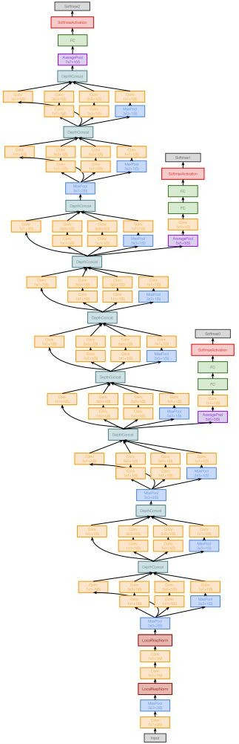
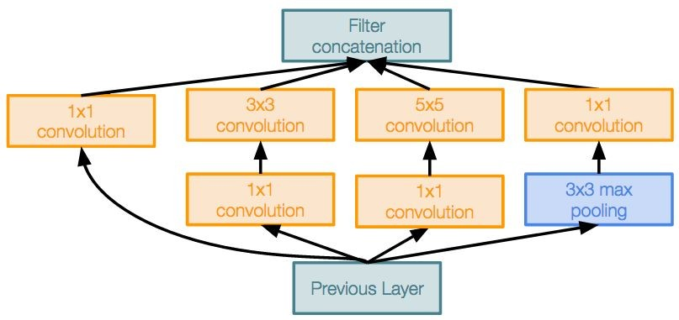
Case Study: GoogLeNet
[Szegedy et al., 2014]
Deeper networks, with computational efficiency
22 layers
Efficient “Inception” module
No FC layers
Only 5 million parameters!
12x less than AlexNet
ILSVRC’14 classification winner (6.7% top 5 error)
Inception module
Fei-Fei Li & Justin Johnson & Serena Yeung Lecture 9 - May 2, 2017

Slide 92
Case Study: GoogLeNet
[Szegedy et al., 2014]
“Inception module”: design a good local network topology (network within a network) and then stack these modules on top of each other
Inception module
Fei-Fei Li & Justin Johnson & Serena Yeung Lecture 9 - May 2, 2017

Slide 93
Case Study: GoogLeNet
[Szegedy et al., 2014]
Apply parallel filter operations on the input from previous layer:
Filter concatenation
Multiple receptive field sizes for convolution (1x1, 3x3, 5x5)
Pooling operation (3x3)
1x1 convolution
3x3 convolution
5x5 convolution
3x3 max pooling
Previous Layer
Concatenate all filter outputs together depth-wise
Naive Inception module
Fei-Fei Li & Justin Johnson & Serena Yeung Lecture 9 - May 2, 2017

Slide 94
Case Study: GoogLeNet
[Szegedy et al., 2014]
Apply parallel filter operations on the input from previous layer:
Filter concatenation
Multiple receptive field sizes for convolution (1x1, 3x3, 5x5)
Pooling operation (3x3)
1x1 convolution
3x3 convolution
5x5 convolution
3x3 max pooling
Previous Layer
Concatenate all filter outputs together depth-wise
Naive Inception module
Q: What is the problem with this? [Hint: Computational complexity]
Fei-Fei Li & Justin Johnson & Serena Yeung Lecture 9 - May 2, 2017

Slide 95
Case Study: GoogLeNet
[Szegedy et al., 2014]
Q: What is the problem with this? [Hint: Computational complexity]
Example:
Filter concatenation
1x1 conv,
128
3x3 conv,
192
5x5 conv,
96
3x3 pool
Module input: 28x28x256
Input
Naive Inception module
Fei-Fei Li & Justin Johnson & Serena Yeung Lecture 9 - May 2, 2017

Slide 96
Case Study: GoogLeNet
Q: What is the problem with this? [Hint: Computational complexity]
[Szegedy et al., 2014]
Example:
Q1: What is the output size of the 1x1 conv, with 128 filters?
Filter concatenation
1x1 conv,
128
3x3 conv,
192
5x5 conv,
96
3x3 pool
Module input: 28x28x256
Input
Naive Inception module
Fei-Fei Li & Justin Johnson & Serena Yeung Lecture 9 - May 2, 2017

Slide 97
Case Study: GoogLeNet
Q: What is the problem with this? [Hint: Computational complexity]
[Szegedy et al., 2014]
Example:
Q1: What is the output size of the 1x1 conv, with 128 filters?
Filter concatenation
28x28x128
1x1 conv,
128
3x3 conv,
192
5x5 conv,
96
3x3 pool
Module input: 28x28x256
Input
Naive Inception module
Fei-Fei Li & Justin Johnson & Serena Yeung Lecture 9 - May 2, 2017

Slide 98
Case Study: GoogLeNet
Q: What is the problem with this? [Hint: Computational complexity]
[Szegedy et al., 2014]
Example:
Q2: What are the output sizes of all different filter operations?
Filter concatenation
28x28x128
1x1 conv,
128
3x3 conv,
192
5x5 conv,
96
3x3 pool
Module input: 28x28x256
Input
Naive Inception module
Fei-Fei Li & Justin Johnson & Serena Yeung Lecture 9 - May 2, 2017

Slide 99
Case Study: GoogLeNet
Q: What is the problem with this? [Hint: Computational complexity]
[Szegedy et al., 2014]
Example:
Q2: What are the output sizes of all different filter operations?
Filter concatenation
28x28x128
28x28x192 28x28x96
28x28x256
1x1 conv,
128
3x3 conv,
192
5x5 conv,
96
3x3 pool
Module input: 28x28x256
Input
Naive Inception module
Fei-Fei Li & Justin Johnson & Serena Yeung Lecture 9 - May 2, 2017

Slide 100
Case Study: GoogLeNet
Q: What is the problem with this? [Hint: Computational complexity]
[Szegedy et al., 2014]
Example:
Q3:What is output size after filter concatenation?
Filter concatenation
28x28x128
28x28x192 28x28x96
28x28x256
1x1 conv,
128
3x3 conv,
192
5x5 conv,
96
3x3 pool
Module input: 28x28x256
Input
Naive Inception module
Fei-Fei Li & Justin Johnson & Serena Yeung Lecture 9 - May 2, 2017

Slide 101
Case Study: GoogLeNet
Q: What is the problem with this? [Hint: Computational complexity]
[Szegedy et al., 2014]
Example:
Q3:What is output size after filter concatenation?
28x28x(128+192+96+256) = 28x28x672
Filter concatenation
28x28x128
28x28x192 28x28x96
28x28x256
1x1 conv,
128
3x3 conv,
192
5x5 conv,
96
3x3 pool
Module input: 28x28x256
Input
Naive Inception module
Fei-Fei Li & Justin Johnson & Serena Yeung Lecture 9 - May 2, 2017

Slide 102
Case Study: GoogLeNet
Q: What is the problem with this? [Hint: Computational complexity]
[Szegedy et al., 2014]
Example:
Q3:What is output size after filter concatenation?
Conv Ops:
[1x1 conv, 128] 28x28x128x1x1x256 [3x3 conv, 192] 28x28x192x3x3x256 [5x5 conv, 96] 28x28x96x5x5x256 Total: 854M ops
28x28x(128+192+96+256) = 28x28x672
Filter concatenation
28x28x128
28x28x192 28x28x96
28x28x256
1x1 conv,
128
3x3 conv,
192
5x5 conv,
96
3x3 pool
Module input: 28x28x256
Input
Naive Inception module
Fei-Fei Li & Justin Johnson & Serena Yeung Lecture 9 - May 2, 2017

Slide 103
Case Study: GoogLeNet
Q: What is the problem with this? [Hint: Computational complexity]
[Szegedy et al., 2014]
Example:
Q3:What is output size after filter concatenation?
Conv Ops:
[1x1 conv, 128] 28x28x128x1x1x256 [3x3 conv, 192] 28x28x192x3x3x256 [5x5 conv, 96] 28x28x96x5x5x256 Total: 854M ops
28x28x(128+192+96+256) = 28x28x672
Filter concatenation
28x28x128
28x28x192 28x28x96
28x28x256
1x1 conv,
128
3x3 conv,
192
5x5 conv,
96
3x3 pool
Very expensive compute
Module input: 28x28x256
Input
Pooling layer also preserves feature depth, which means total depth after concatenation can only grow at every layer!
Naive Inception module
Fei-Fei Li & Justin Johnson & Serena Yeung Lecture 9 - May 2, 2017

Slide 104
Case Study: GoogLeNet
Q: What is the problem with this? [Hint: Computational complexity]
[Szegedy et al., 2014]
Example:
Q3:What is output size after filter concatenation?
28x28x(128+192+96+256) = 529k
Solution: “bottleneck” layers that use 1x1 convolutions to reduce feature depth
Filter concatenation
28x28x128
28x28x192 28x28x96
28x28x256
1x1 conv,
128
3x3 conv,
192
5x5 conv,
96
3x3 pool
Module input: 28x28x256
Input
Naive Inception module
Fei-Fei Li & Justin Johnson & Serena Yeung Lecture 9 - May 2, 2017

Slide 105
Reminder: 1x1 convolutions
1x1 CONV
with 32 filters
56
56
(each filter has size 1x1x64, and performs a 64-dimensional dot product)
56
56
64
32
Fei-Fei Li & Justin Johnson & Serena Yeung Lecture 9 - May 2, 2017

Slide 106
Reminder: 1x1 convolutions
1x1 CONV
with 32 filters
56
56
preserves spatial dimensions, reduces depth!
56
Projects depth to lower dimension (combination of feature maps)
56
64
32
Fei-Fei Li & Justin Johnson & Serena Yeung Lecture 9 - May 2, 2017

Slide 107
Case Study: GoogLeNet
[Szegedy et al., 2014]
Filter concatenation
Filter concatenation
1x1 convolution
3x3 convolution
5x5 convolution
3x3 max pooling
1x1 convolution
3x3 convolution
5x5 convolution
1x1 convolution
1x1 convolution
1x1 convolution
3x3 max pooling
Previous Layer
Previous Layer
Naive Inception module
Inception module with dimension reduction
Fei-Fei Li & Justin Johnson & Serena Yeung Lecture 9 - May 2, 2017

Slide 108
Case Study: GoogLeNet
[Szegedy et al., 2014]
1x1 conv “bottleneck” layers
Filter concatenation
Filter concatenation
1x1 convolution
3x3 convolution
5x5 convolution
3x3 max pooling
1x1 convolution
3x3 convolution
5x5 convolution
1x1 convolution
1x1 convolution
1x1 convolution
3x3 max pooling
Previous Layer
Previous Layer
Naive Inception module
Inception module with dimension reduction
Fei-Fei Li & Justin Johnson & Serena Yeung Lecture 9 - May 2, 2017

Slide 109
Case Study: GoogLeNet
[Szegedy et al., 2014]
Using same parallel layers as naive example, and adding “1x1 conv, 64 filter” bottlenecks:
28x28x480
Filter concatenation
Conv Ops:
[1x1 conv, 64] 28x28x64x1x1x256 [1x1 conv, 64] 28x28x64x1x1x256 [1x1 conv, 128] 28x28x128x1x1x256 [3x3 conv, 192] 28x28x192x3x3x64 [5x5 conv, 96] 28x28x96x5x5x64 [1x1 conv, 64] 28x28x64x1x1x256 Total: 358M ops
28x28x128
28x28x192 28x28x96
28x28x64
1x1 conv,
128
3x3 conv,
192
5x5 conv,
96
1x1 conv,
64
28x28x64
28x28x64
28x28x256
1x1 conv, 64
1x1 conv, 64
3x3 pool
Module input: 28x28x256
Previous Layer
Compared to 854M ops for naive version Bottleneck can also reduce depth after pooling layer
Inception module with dimension reduction
Fei-Fei Li & Justin Johnson & Serena Yeung Lecture 9 - May 2, 2017

Slide 110
Case Study: GoogLeNet
[Szegedy et al., 2014]
Stack Inception modules with dimension reduction on top of each other
Inception module
Fei-Fei Li & Justin Johnson & Serena Yeung Lecture 9 - May 2, 2017

Slide 111
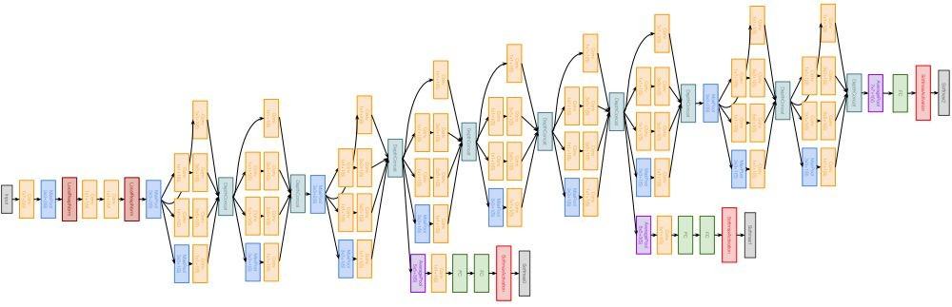
Case Study: GoogLeNet
[Szegedy et al., 2014]
Full GoogLeNet architecture
Stem Network: Conv-Pool- 2x Conv-Pool
Fei-Fei Li & Justin Johnson & Serena Yeung Lecture 9 - May 2, 2017

Slide 112
Case Study: GoogLeNet
[Szegedy et al., 2014]
Full GoogLeNet architecture
Stacked Inception Modules
Fei-Fei Li & Justin Johnson & Serena Yeung Lecture 9 - May 2, 2017

Slide 113
Case Study: GoogLeNet
[Szegedy et al., 2014]
Full GoogLeNet architecture
Classifier output
Fei-Fei Li & Justin Johnson & Serena Yeung Lecture 9 - May 2, 2017

Slide 114
Case Study: GoogLeNet
[Szegedy et al., 2014]
Full GoogLeNet architecture
Classifier output (removed expensive FC layers!)
Fei-Fei Li & Justin Johnson & Serena Yeung Lecture 9 - May 2, 2017

Slide 115
Case Study: GoogLeNet
[Szegedy et al., 2014]
Full GoogLeNet architecture
Auxiliary classification outputs to inject additional gradient at lower layers (AvgPool-1x1Conv-FC-FC-Softmax)
Fei-Fei Li & Justin Johnson & Serena Yeung Lecture 9 - May 2, 2017

Slide 116
Case Study: GoogLeNet
[Szegedy et al., 2014]
Full GoogLeNet architecture
22 total layers with weights (including each parallel layer in an Inception module)
Fei-Fei Li & Justin Johnson & Serena Yeung Lecture 9 - May 2, 2017

Slide 117
Case Study: GoogLeNet
[Szegedy et al., 2014]
Deeper networks, with computational efficiency
22 layers
Efficient “Inception” module
No FC layers
12x less params than AlexNet
ILSVRC’14 classification winner (6.7% top 5 error)
Inception module
Fei-Fei Li & Justin Johnson & Serena Yeung Lecture 9 - May 2, 2017

Slide 118
ImageNet Large Scale Visual Recognition Challenge (ILSVRC) winners
“Revolution of Depth”
Fei-Fei Li & Justin Johnson & Serena Yeung Lecture 9 - May 2, 2017

Slide 119
Case Study: ResNet
[He et al., 2015]
Softmax
FC 1000
Pool
3x3 conv, 64
3x3 conv, 64
relu
3x3 conv, 64
Very deep networks using residual connections
3x3 conv, 64
F(x) + x
3x3 conv, 64
3x3 conv, 64
..
.
conv
152-layer model for ImageNet
ILSVRC’15 classification winner (3.57% top 5 error)
Swept all classification and detection competitions in ILSVRC’15 and COCO’15!
X
identity
3x3 conv, 128
F(x)
relu
3x3 conv, 128
3x3 conv, 128
conv
3x3 conv, 128
3x3 conv, 128
3x3 conv, 128 / 2
3x3 conv, 64
X
Residual block
3x3 conv, 64
3x3 conv, 64
3x3 conv, 64
3x3 conv, 64
3x3 conv, 64
Pool
7x7 conv, 64 / 2
Input
Fei-Fei Li & Justin Johnson & Serena Yeung Lecture 9 - May 2, 2017

Slide 120
Case Study: ResNet
[He et al., 2015]
What happens when we continue stacking deeper layers on a “plain” convolutional neural network?
Fei-Fei Li & Justin Johnson & Serena Yeung Lecture 9 - May 2, 2017

Slide 121
Case Study: ResNet
[He et al., 2015]
What happens when we continue stacking deeper layers on a “plain” convolutional neural network?
56-layer
Training error
56-layer
Test error
20-layer
20-layer
Iterations
Iterations
Q: What’s strange about these training and test curves? [Hint: look at the order of the curves]
Fei-Fei Li & Justin Johnson & Serena Yeung Lecture 9 - May 2, 2017

Slide 122
Case Study: ResNet
[He et al., 2015]
What happens when we continue stacking deeper layers on a “plain” convolutional neural network?
56-layer
Training error
56-layer
Test error
20-layer
20-layer
Iterations
Iterations
56-layer model performs worse on both training and test error
-> The deeper model performs worse, but it’s not caused by overfitting!
Fei-Fei Li & Justin Johnson & Serena Yeung Lecture 9 - May 2, 2017

Slide 123
Case Study: ResNet
[He et al., 2015]
Hypothesis: the problem is an optimization problem, deeper models are harder to optimize
Fei-Fei Li & Justin Johnson & Serena Yeung Lecture 9 - May 2, 2017

Slide 124
Case Study: ResNet
[He et al., 2015]
Hypothesis: the problem is an optimization problem, deeper models are harder to optimize
The deeper model should be able to perform at least as well as the shallower model.
A solution by construction is copying the learned layers from the shallower model and setting additional layers to identity mapping.
Fei-Fei Li & Justin Johnson & Serena Yeung Lecture 9 - May 2, 2017

Slide 125
Case Study: ResNet
[He et al., 2015]
Solution: Use network layers to fit a residual mapping instead of directly trying to fit a desired underlying mapping
relu
H(x)
F(x) + x
conv
conv
F(x)
relu
X
identity
 | relu
conv
conv
X
“Plain” layers
X
Residual block
Fei-Fei Li & Justin Johnson & Serena Yeung Lecture 9 - May 2, 2017

Slide 126
Case Study: ResNet
[He et al., 2015]
Solution: Use network layers to fit a residual mapping instead of directly trying to fit a desired underlying mapping
H(x) = F(x) + x
relu
H(x)
F(x) + x
Use layers to fit residual F(x) = H(x) - x
instead of H(x) directly
conv
conv
F(x)
relu
X
identity
 | relu
conv
conv
X
“Plain” layers
X
Residual block
Fei-Fei Li & Justin Johnson & Serena Yeung Lecture 9 - May 2, 2017

Slide 127
Case Study: ResNet
[He et al., 2015]
Softmax
FC 1000
Pool
3x3 conv, 512
3x3 conv, 512
Full ResNet architecture:
3x3 conv, 512
relu
3x3 conv, 512
Stack residual blocks
Every residual block has two 3x3 conv layers
3x3 conv, 512
F(x) + x
3x3 conv, 512, /2
..
.
3x3 conv
3x3 conv, 128
3x3 conv, 128
F(x)
relu
X
identity
3x3 conv, 128
3x3 conv, 128
3x3 conv
3x3 conv, 128
3x3 conv, 128, / 2
3x3 conv, 64
3x3 conv, 64
X
Residual block
3x3 conv, 64
3x3 conv, 64
3x3 conv, 64
3x3 conv, 64
Pool
7x7 conv, 64, / 2
Input
Fei-Fei Li & Justin Johnson & Serena Yeung Lecture 9 - May 2, 2017

Slide 128
Case Study: ResNet
[He et al., 2015]
Softmax
FC 1000
Pool
3x3 conv, 512
3x3 conv, 512
Full ResNet architecture:
3x3 conv, 512
relu
3x3 conv, 512
Stack residual blocks
Every residual block has two 3x3 conv layers
Periodically, double # of filters and downsample spatially using stride 2 (/2 in each dimension)
3x3 conv, 512
F(x) + x
3x3 conv, 512, /2
..
.
3x3 conv
3x3 conv, 128
3x3 conv, 128
3x3 conv, 128 filters, /2 spatially with stride 2
F(x)
relu
X
identity
3x3 conv, 128
3x3 conv, 128
3x3 conv
3x3 conv, 128
3x3 conv, 128, / 2
3x3 conv, 64
3x3 conv, 64 filters
3x3 conv, 64
X
Residual block
3x3 conv, 64
3x3 conv, 64
3x3 conv, 64
3x3 conv, 64
Pool
7x7 conv, 64, / 2
Input
Fei-Fei Li & Justin Johnson & Serena Yeung Lecture 9 - May 2, 2017

Slide 129
Case Study: ResNet
[He et al., 2015]
Softmax
FC 1000
Pool
3x3 conv, 512
3x3 conv, 512
Full ResNet architecture:
3x3 conv, 512
relu
3x3 conv, 512
Stack residual blocks
Every residual block has two 3x3 conv layers
Periodically, double # of filters and downsample spatially using stride 2 (/2 in each dimension)
Additional conv layer at the beginning
3x3 conv, 512
F(x) + x
3x3 conv, 512, /2
..
.
3x3 conv
3x3 conv, 128
3x3 conv, 128
F(x)
relu
X
identity
3x3 conv, 128
3x3 conv, 128
3x3 conv
3x3 conv, 128
3x3 conv, 128, / 2
3x3 conv, 64
3x3 conv, 64
X
Residual block
3x3 conv, 64
3x3 conv, 64
3x3 conv, 64
3x3 conv, 64
Pool
7x7 conv, 64, / 2
Input
Beginning conv layer
Fei-Fei Li & Justin Johnson & Serena Yeung Lecture 9 - May 2, 2017

Slide 130
Case Study: ResNet
[He et al., 2015]
Softmax
FC 1000
Pool
No FC layers
besides FC 1000 to output classes
3x3 conv, 512
3x3 conv, 512
Full ResNet architecture:
3x3 conv, 512
relu
3x3 conv, 512
Global average pooling layer after last conv layer
Stack residual blocks
Every residual block has two 3x3 conv layers
Periodically, double # of filters and downsample spatially using stride 2 (/2 in each dimension)
Additional conv layer at the beginning
No FC layers at the end (only FC 1000 to output classes)
3x3 conv, 512
F(x) + x
3x3 conv, 512, /2
..
.
3x3 conv
3x3 conv, 128
3x3 conv, 128
F(x)
relu
X
identity
3x3 conv, 128
3x3 conv, 128
3x3 conv
3x3 conv, 128
3x3 conv, 128, / 2
3x3 conv, 64
3x3 conv, 64
X
Residual block
3x3 conv, 64
3x3 conv, 64
3x3 conv, 64
3x3 conv, 64
Pool
7x7 conv, 64, / 2
Input
Fei-Fei Li & Justin Johnson & Serena Yeung Lecture 9 - May 2, 2017

Slide 131
Case Study: ResNet
[He et al., 2015]
Softmax
FC 1000
Pool
3x3 conv, 512
3x3 conv, 512
3x3 conv, 512
3x3 conv, 512
3x3 conv, 512
Total depths of 34, 50, 101, or 152 layers for ImageNet
3x3 conv, 512, /2
..
.
3x3 conv, 128
3x3 conv, 128
3x3 conv, 128
3x3 conv, 128
3x3 conv, 128
3x3 conv, 128, / 2
3x3 conv, 64
3x3 conv, 64
3x3 conv, 64
3x3 conv, 64
3x3 conv, 64
3x3 conv, 64
Pool
7x7 conv, 64, / 2
Input
Fei-Fei Li & Justin Johnson & Serena Yeung Lecture 9 - May 2, 2017

Slide 132

Case Study: ResNet
[He et al., 2015]
28x28x256
output
For deeper networks
(ResNet-50+), use “bottleneck” layer to improve efficiency (similar to GoogLeNet)
1x1 conv, 256
3x3 conv, 64
1x1 conv, 64
28x28x256
input
Fei-Fei Li & Justin Johnson & Serena Yeung Lecture 9 - May 2, 2017

Slide 133
Case Study: ResNet
[He et al., 2015]
28x28x256
output
1x1 conv, 256 filters projects
For deeper networks
(ResNet-50+), use “bottleneck” layer to improve efficiency (similar to GoogLeNet)
back to 256 feature maps (28x28x256)
1x1 conv, 256
3x3 conv operates over only 64 feature maps
3x3 conv, 64
1x1 conv, 64 filters to project to 28x28x64
1x1 conv, 64
28x28x256
input
Fei-Fei Li & Justin Johnson & Serena Yeung Lecture 9 - May 2, 2017

Slide 134
Case Study: ResNet
[He et al., 2015]
Training ResNet in practice:
Batch Normalization after every CONV layer
Xavier/2 initialization from He et al.
SGD + Momentum (0.9)
Learning rate: 0.1, divided by 10 when validation error plateaus
Mini-batch size 256
Weight decay of 1e-5
No dropout used
Fei-Fei Li & Justin Johnson & Serena Yeung Lecture 9 - May 2, 2017

Slide 135
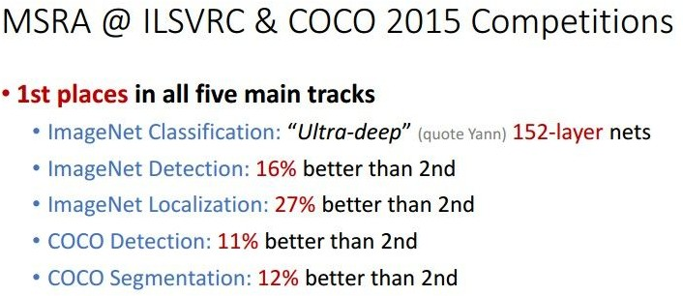
Case Study: ResNet
[He et al., 2015]
Experimental Results
Able to train very deep networks without degrading (152 layers on ImageNet, 1202 on Cifar)
Deeper networks now achieve lowing training error as expected
Swept 1st place in all ILSVRC and COCO 2015 competitions
Fei-Fei Li & Justin Johnson & Serena Yeung Lecture 9 - May 2, 2017

Slide 136
Case Study: ResNet
[He et al., 2015]
Experimental Results
Able to train very deep networks without degrading (152 layers on ImageNet, 1202 on Cifar)
Deeper networks now achieve lowing training error as expected
Swept 1st place in all ILSVRC and COCO 2015 competitions
ILSVRC 2015 classification winner (3.6% top 5 error) -- better than “human performance”! (Russakovsky 2014)
Fei-Fei Li & Justin Johnson & Serena Yeung Lecture 9 - May 2, 2017

Slide 137
ImageNet Large Scale Visual Recognition Challenge (ILSVRC) winners
Fei-Fei Li & Justin Johnson & Serena Yeung Lecture 9 - May 2, 2017

Slide 138
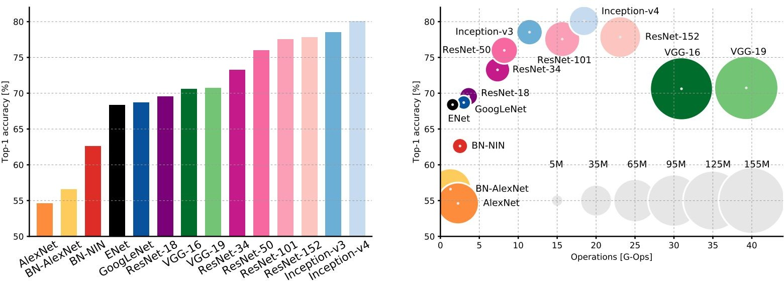
Comparing complexity...
An Analysis of Deep Neural Network Models for Practical Applications, 2017.
Figures copyright Alfredo Canziani, Adam Paszke, Eugenio Culurciello, 2017. Reproduced with permission.
Fei-Fei Li & Justin Johnson & Serena Yeung Lecture 9 - May 2, 2017

Slide 139
Comparing complexity...
Inception-v4: Resnet + Inception!
An Analysis of Deep Neural Network Models for Practical Applications, 2017.
Figures copyright Alfredo Canziani, Adam Paszke, Eugenio Culurciello, 2017. Reproduced with permission.
Fei-Fei Li & Justin Johnson & Serena Yeung Lecture 9 - May 2, 2017

Slide 140
Comparing complexity...
VGG: Highest memory, most operations
An Analysis of Deep Neural Network Models for Practical Applications, 2017.
Figures copyright Alfredo Canziani, Adam Paszke, Eugenio Culurciello, 2017. Reproduced with permission.
Fei-Fei Li & Justin Johnson & Serena Yeung Lecture 9 - May 2, 2017

Slide 141
GoogLeNet: most efficient
Comparing complexity...
An Analysis of Deep Neural Network Models for Practical Applications, 2017.
Figures copyright Alfredo Canziani, Adam Paszke, Eugenio Culurciello, 2017. Reproduced with permission.
Fei-Fei Li & Justin Johnson & Serena Yeung Lecture 9 - May 2, 2017

Slide 142
Comparing complexity...
AlexNet:
Smaller compute, still memory heavy, lower accuracy
An Analysis of Deep Neural Network Models for Practical Applications, 2017.
Figures copyright Alfredo Canziani, Adam Paszke, Eugenio Culurciello, 2017. Reproduced with permission.
Fei-Fei Li & Justin Johnson & Serena Yeung Lecture 9 - May 2, 2017

Slide 143
ResNet:
Moderate efficiency depending on model, highest accuracy
Comparing complexity...
An Analysis of Deep Neural Network Models for Practical Applications, 2017.
Figures copyright Alfredo Canziani, Adam Paszke, Eugenio Culurciello, 2017. Reproduced with permission.
Fei-Fei Li & Justin Johnson & Serena Yeung Lecture 9 - May 2, 2017

Slide 144
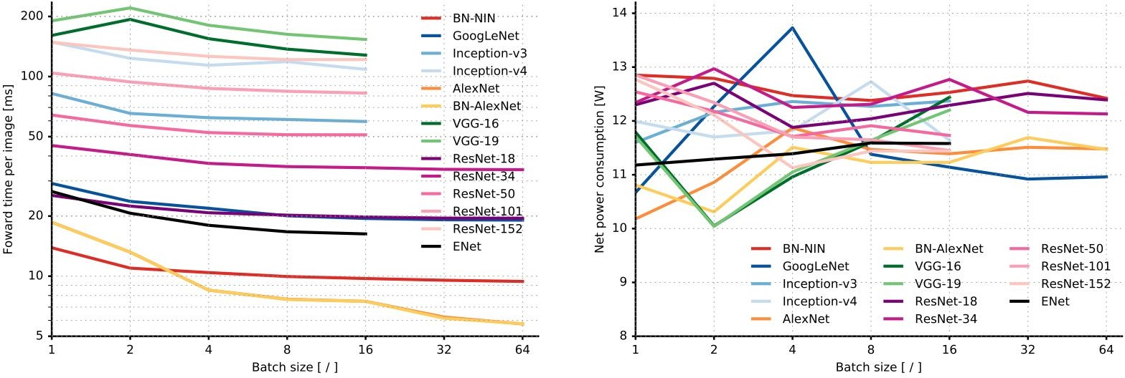
Forward pass time and power consumption
An Analysis of Deep Neural Network Models for Practical Applications, 2017.
Figures copyright Alfredo Canziani, Adam Paszke, Eugenio Culurciello, 2017. Reproduced with permission.
Fei-Fei Li & Justin Johnson & Serena Yeung Lecture 9 - May 2, 2017

Slide 145
Other architectures to know...

Slide 146
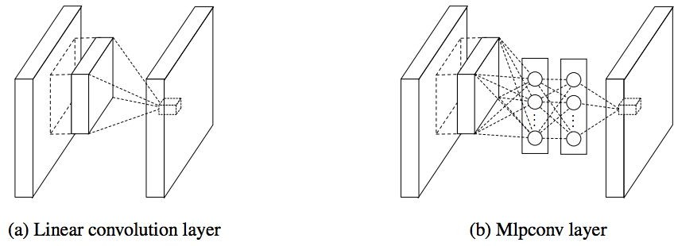
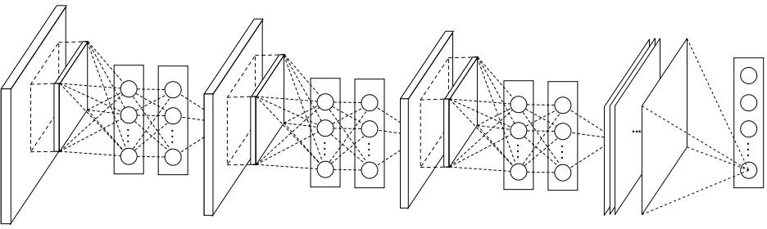
Network in Network (NiN)
[Lin et al. 2014]
Mlpconv layer with “micronetwork” within each conv layer to compute more abstract features for local patches
Micronetwork uses multilayer perceptron (FC, i.e. 1x1 conv layers)
Precursor to GoogLeNet and ResNet “bottleneck” layers
Philosophical inspiration for GoogLeNet
Figures copyright Lin et al., 2014. Reproduced with permission.

Slide 147

Improving ResNets...
Identity Mappings in Deep Residual Networks
[He et al. 2016]
Improved ResNet block design from creators of ResNet
Creates a more direct path for propagating information throughout network (moves activation to residual mapping pathway)
Gives better performance
conv
ReLU
BN
conv
ReLU
BN

Slide 148
Improving ResNets...
Wide Residual Networks
[Zagoruyko et al. 2016]
Argues that residuals are the important factor, not depth
User wider residual blocks (F x k filters instead of F filters in each layer)
50-layer wide ResNet outperforms 152-layer original ResNet
Increasing width instead of depth more computationally efficient (parallelizable)
3x3 conv, F
3x3 conv, F x k
3x3 conv, F
3x3 conv, F x k
Basic residual block
Wide residual block

Slide 149



Improving ResNets...
Aggregated Residual Transformations for Deep
Neural Networks (ResNeXt)
[Xie et al. 2016]
256-d out
Also from creators of ResNet
Increases width of residual block through multiple parallel pathways (“cardinality”)
Parallel pathways similar in spirit to Inception module
256-d out
1x1 conv, 256
1x1 conv, 256
1x1 conv, 256
1x1 conv, 256
32
3x3 conv, 64
3x3 conv, 4
3x3 conv, 4
paths
3x3 conv, 4
...
1x1 conv, 64
1x1 conv, 4
1x1 conv, 4
1x1 conv, 4
256-d in
256-d in

Slide 150
Improving ResNets...
Deep Networks with Stochastic Depth
[Huang et al. 2016]
Motivation: reduce vanishing gradients and training time through short networks during training
Randomly drop a subset of layers during each training pass
Bypass with identity function
Use full deep network at test time

Slide 151
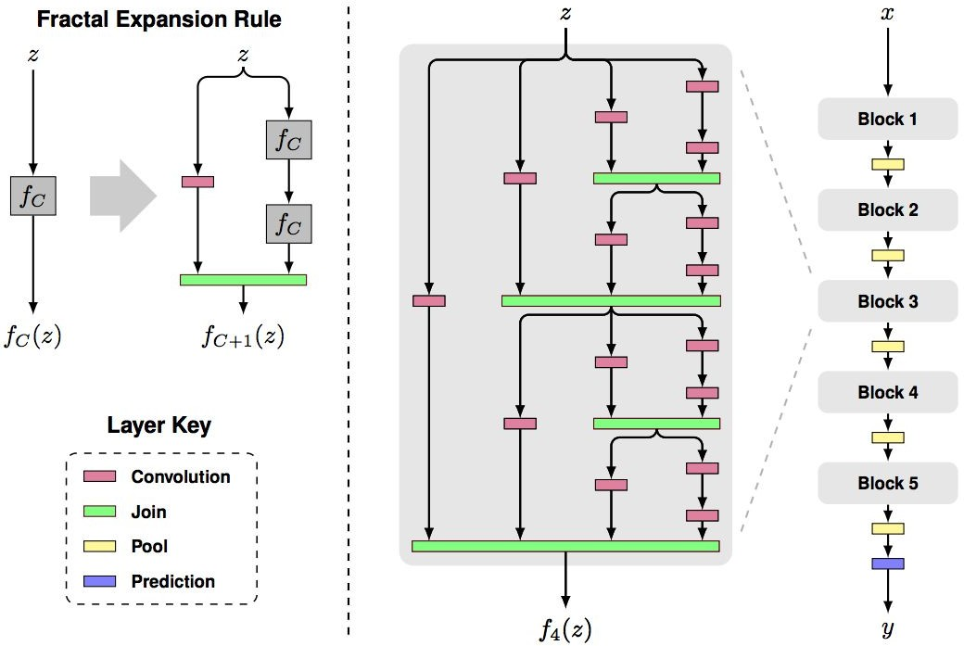
Beyond ResNets...
FractalNet: Ultra-Deep Neural Networks without Residuals
[Larsson et al. 2017]
Argues that key is transitioning effectively from shallow to deep and residual representations are not necessary
Fractal architecture with both shallow and deep paths to output
Trained with dropping out sub-paths
Full network at test time
Figures copyright Larsson et al., 2017. Reproduced with permission.

Slide 152
Beyond ResNets...
Densely Connected Convolutional Networks
Softmax
[Huang et al. 2017]
FC
1x1 conv, 64
Pool
Dense blocks where each layer is connected to every other layer in feedforward fashion
Alleviates vanishing gradient, strengthens feature propagation, encourages feature reuse
Dense Block 3
Concat
Conv
1x1 conv, 64
Pool
Conv
Concat
Dense Block 2
Conv
Conv
Pool
Concat
Conv
Conv
Dense Block 1
Conv
Input
Input
Dense Block
Lecture 9 -
Fei-Fei Li & Justin Johnson & Serena Yeung Lecture 9 - May 2, 2017

Slide 153
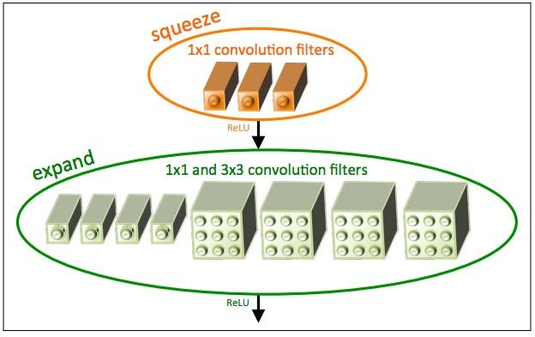
Efficient networks...
SqueezeNet: AlexNet-level Accuracy With 50x Fewer Parameters and <0.5Mb Model Size
[Iandola et al. 2017]
Fire modules consisting of a ‘squeeze’ layer with 1x1 filters feeding an ‘expand’ layer with 1x1 and 3x3 filters
AlexNet level accuracy on ImageNet with 50x fewer parameters
Can compress to 510x smaller than AlexNet (0.5Mb)
Figure copyright Iandola, Han, Moskewicz, Ashraf, Dally, Keutzer, 2017. Reproduced with permission.
Lecture 9 -
Fei-Fei Li & Justin Johnson & Serena Yeung Lecture 9 - May 2, 2017

Slide 154
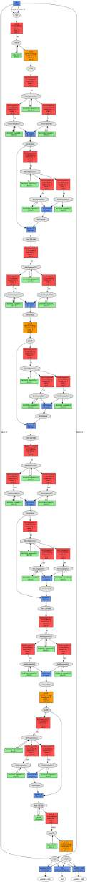



SqueezeNet
Input
64
1x1 Conv Squeeze
16
1x1 Conv Expand
3x3 Conv Expand
64 64
Output Concat/Eltwise
128
Iandola et al, “SqueezeNet: AlexNet-level accuracy with 50x fewer parameters and <0.5MB model size”, arXiv 2016
Compression
Acceleration
Regularization

Slide 155
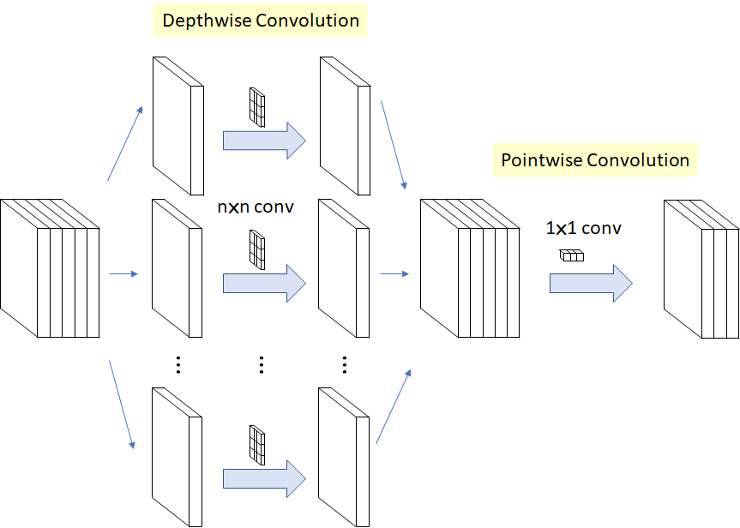
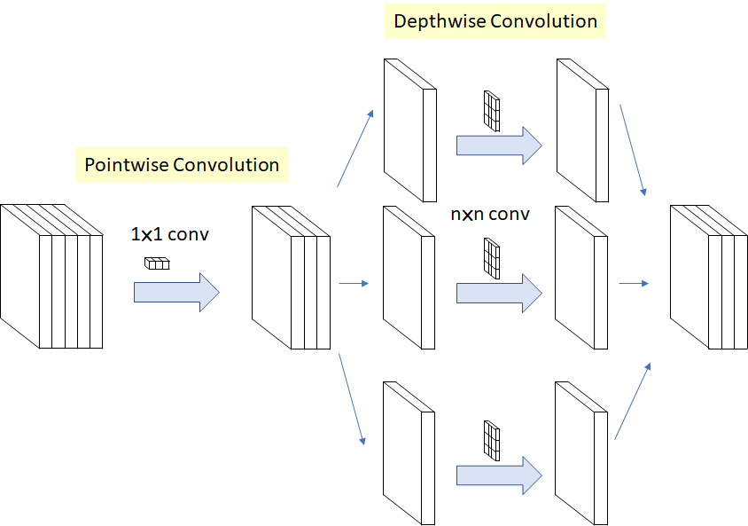
Xception Module
16
32
3x3
656 (16x3x3 + 16x32x1x1) parameters opposed to the 4608 (16x32x3x3)
https://arxiv.org/abs/1610.02357

Slide 156
Summary: CNN Architectures
Case Studies
AlexNet
VGG
GoogLeNet
ResNet
Also....
NiN (Network in Network)
Wide ResNet
ResNeXT
Stochastic Depth
DenseNet
FractalNet
SqueezeNet
Xception Module
Fei-Fei Li & Justin Johnson & Serena Yeung
Lecture 9 - ¹⁰
May 2, 2017
0

Slide 157
Sources
http://cs231n.stanford.edu/2017/syllabus.html

